Slide 1
MedLife
- By Kishor Nivalkar
02/04/2019

Slide 2
Problem Statement
In the current system, if we need some medicines then we go to the shop for buy. If the medicine is not available in one shop then we will go to another shop.
Purpose System is the solution for customer, here solution is to developing the MedLab system. so that it is easy to transact your tablets or medicines from Shop for customer.
In this system, we can search the medicine in different shop that the medicines are currently available are not , we can get trade of customer and we can buy the medicine.
Customer is able to find the transaction happen in per day.

Slide 3
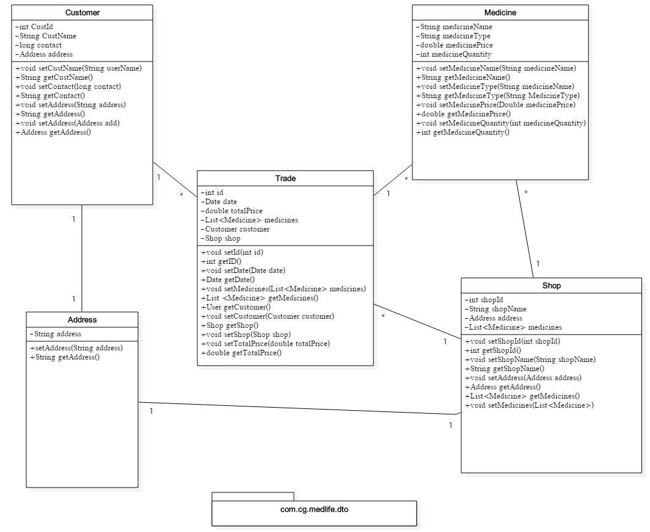
POJO Classes / DTO

Slide 4
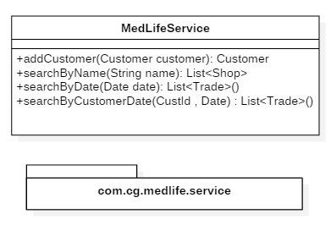
Service Interface

Slide 5
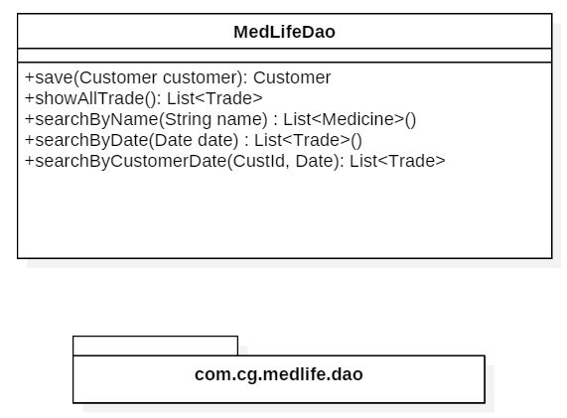
Repository

Slide 6
Thank You

